Slide 1
INTRODUCTION TO JAVA
What is JAVA?
Java is a general-purpose, class-based, object-oriented and secure programming language and a platform.
Java is a high-level programming language originally developed by Sun Microsystems and released in 1995. Java runs on a variety of platforms, such as Windows, Mac OS, and the various versions of UNIX.
Java was developed by Sun Microsystems in the year 1995. James Gosling is known as the father of Java. Before Java, its name was Oak. Since Oak was already a registered company, so James Gosling and his team changed the Oak name to Java.
Platform: Any hardware or software environment in which a program runs, is known as a platform. Since Java has a runtime environment (JRE) and API, it is called a platform.

Slide 2
Application
There are many devices where Java is currently used. Some of them are as follows:
Desktop Applications such as acrobat reader, media player, antivirus, etc.
Web Applications such as irctc.co.in
Enterprise Applications such as banking applications.
Mobile
Embedded System
Smart Card
Robotics
Games, etc.

Slide 3
Types of Java Applications
Standalone Application
Standalone applications are also known as desktop applications or window-based applications. These are traditional software that we need to install on every machine. Examples of standalone application are Media player, antivirus, etc.
2) Web Application
An application that runs on the server side and creates a dynamic page is called a web application.
Currently, Servlet, JSP, Spring, Hibernate etc. technologies are used for creating web applications in Java.
3) Enterprise Application
An application that is distributed in nature, such as banking applications, etc. is called enterprise application. It has advantages of the high-level security, load balancing.
4) Mobile Application
An application which is created for mobile devices is called a mobile application. Currently, Android and Java ME are used for creating mobile applications.

Slide 4
Why to Learn java Programming?
Object Oriented −
In Java, everything is an Object. Java can be easily extended since it is based on the Object model.
2) Platform Independent −
Unlike many other programming languages including C and C++, when Java is compiled,
it is not compiled into platform specific machine, rather into platform independent byte code.
This byte code is distributed over the web and interpreted by the Virtual Machine (JVM)
on whichever platform it is being run on.
3) Simple −
Java is designed to be easy to learn. If you understand the basic concept of OOP Java,
it would be easy to master.
4) Secure −
With Java's secure feature it enables to develop virus-free, tamper-free systems.
Authentication techniques are based on public-key encryption.

Slide 5
Why to Learn java Programming?
5)Portable −
Being architecture-neutral and having no implementation dependent aspects of the specification makes Java portable. Compiler in Java is written in ANSI C with a clean
portability boundary.
6)Robust −
Java makes an effort to eliminate error situations by emphasizing mainly on
compile time error checking and runtime checking.
7)Architecture-neutral −
Java compiler generates an architecture-neutral object file format, which makes the compiled code executable on many processors, with the presence of
Java runtime system.

Slide 6
Java Platforms / Editions
There are 4 platforms or editions of Java:
Java SE (Java Standard Edition)
It is a Java programming platform. It includes Java programming APIs such as java.io, java.net, java.util, java.sql, java.math etc. It includes core topics like OOPs, String, Regex, Exception, Inner classes, Multithreading, I/O Stream, Networking, Reflection, Collection, etc.
2) Java EE (Java Enterprise Edition)
It is an enterprise platform which is mainly used to develop web and enterprise applications. It is built on the top of the Java SE platform. It includes topics like Servlet, JSP, Web Services etc.
3)Java ME (Java Micro Edition)
It is a micro platform which is mainly used to develop mobile applications.
4) JavaFX
It is used to develop rich internet applications. It uses a light-weight user interface API.

Slide 7
Java Development kit (JDK)
JDK is a software development environment used for making applets and Java applications. The full form of JDK is Java Development Kit. Java developers can use it on Windows, macOS, Solaris, and Linux. JDK helps to code and run Java programs. It is possible to install more than one JDK version on the same computer.
It contains JRE + development tools.
Why use JDK?
Here are the main reasons for using JDK:
JDK contains tools required to write Java programs and JRE to execute them.
It includes a compiler, Java application launcher, Applet viewer, etc.
Compiler converts code written in Java into byte code.
Java application launcher opens a JRE, loads the necessary class, and executes its main method.

Slide 8
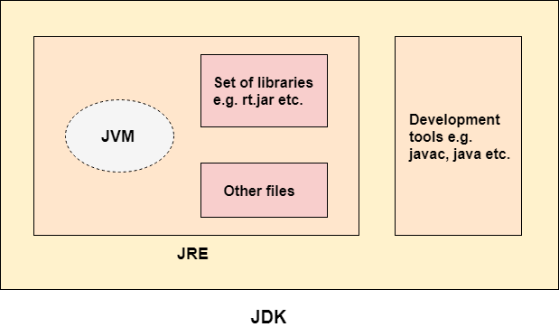
The JDK contains a private Java Virtual Machine (JVM) and a few other resources such as an interpreter/loader (java), a compiler (javac), an archiver (jar), a documentation generator (Javadoc), etc. to complete the development of a Java Application.

Slide 9
Java Runtime Environment (JRE)
JRE is Java Runtime Environment. The Java Runtime Environment is a set of software tools which are used for developing Java applications. It is used to provide the runtime environment. It is the implementation of JVM. It physically exists. It contains a set of libraries + other files that JVM uses at runtime.
Why use JRE?
Here are the main reasons of using JRE:
JRE contains class libraries, JVM, and other supporting files. It does not include any tool for Java development like a debugger, compiler, etc.
It uses important package classes like math, swing, util, lang, awt, and runtime libraries.
If you have to run Java applets, then JRE must be installed in your system.

Slide 10
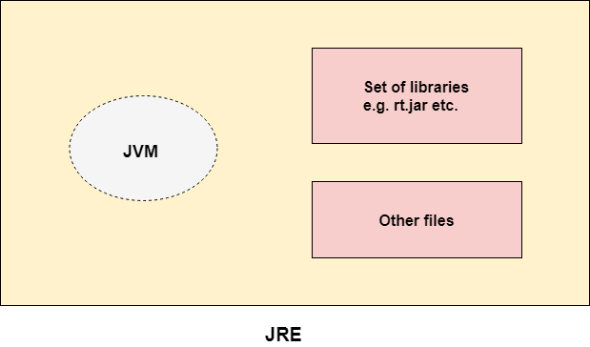
Java Runtime Environment (JRE)

Slide 11
Java Virtual Machine (JVM):
Java Virtual Machine (JVM) is an engine that provides a runtime environment to drive the Java Code or applications. It converts Java bytecode into machine language. JVM is a part of the Java Run Environment (JRE). In other programming languages, the compiler produces machine code for a particular system. However, the Java compiler produces code for a Virtual Machine known as Java Virtual Machine.
Why JVM?
Here are the important reasons of using JVM:
JVM provides a platform-independent way of executing Java source code.
It has numerous libraries, tools, and frameworks.
Once you run a Java program, you can run on any platform and save lots of time.
JVM comes with JIT (Just-in-Time) compiler that converts Java source code into low-level machine language. Hence, it runs faster than a regular application.

Slide 12
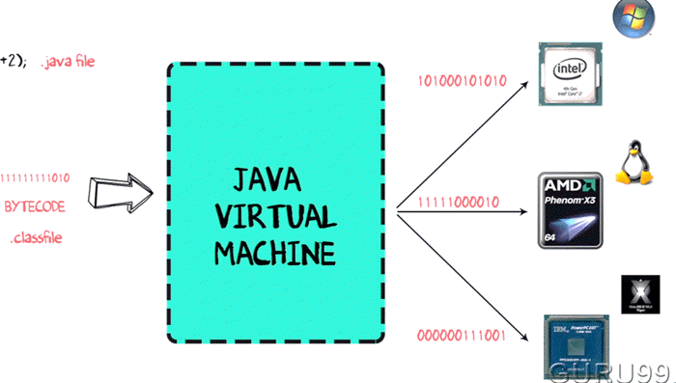
Working of JVM –
Java Virtual Machine (JVM) is a engine that provides runtime environment to drive the Java Code or applications.
It converts Java bytecode into machines language. JVM is a part of Java Run Environment (JRE).

Slide 13
Creating Hello World Example :
class Simple
{
public static void main(String args[])
{
System.out.println("Hello Java");
}
}

Slide 14
Parameters used in First Java Program
class keyword is used to declare a class in java.
public keyword is an access modifier which represents visibility. It means it is visible to all.
static is a keyword. If we declare any method as static, it is known as the static method. The core advantage of the static method is that there is no need to create an object to invoke the static method.
void is the return type of the method. It means it doesn't return any value.
main represents the starting point of the program.
String[] args is used for command line argument.
System.out.println() is a statement which prints the argument passed to it. The println() method display results on the monitor.

Slide 15
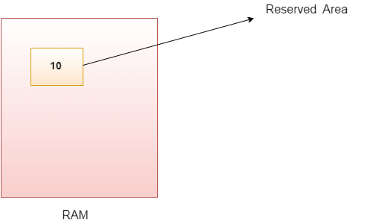
Java Variables :
Variable is name of reserved area allocated in memory. In other words, it is a name of memory location.
A variable is a container which holds the value while the Java program is executed.
A variable is assigned with a data type.
int X=10;
X

Slide 16
Types of Variables :
There are three types of variables in Java:
local variable
instance variable
static variable
Local Variable
A variable declared inside the body of the method is called local variable. You can use this variable only within that method and the other methods in the class aren't even aware that the variable exists.
2) Instance Variable
A variable declared inside the class but outside the body of the method, is called instance variable.
3) Static variable
A variable which is declared as static is called static variable. It cannot be local. You can create a single copy of static variable and share among all the instances of the class. Memory allocation for static variable happens only once when the class is loaded in the memory.

Slide 17
Data Types in Java :
Data types specify the different sizes and values that can be stored in the variable.
There are two types of data types in Java:
Primitive data types:
The primitive data types include boolean, char, byte, short, int, long, float and double.
2. Non-primitive data types:
The non-primitive data types include Classes, Interfaces, and Arrays.
Data Type | Keyword | Default size | Min | Max
boolean | boolean | NA | false | true
character | char | 2 byte | 0 | 65535
byte | byte | 1 byte | -128 | 127
short | short | 2 byte | -32768 | 32767
integer | int | 4 byte | - 2,147,483,648 | 2,147,483,647
long | long | 8 byte | -9,223,372,036,854,775,808 | 9,223,372,036,854,775,807
float | float | 4 byte | 1.4e-45 | 3.4e+38
double | double | 8 byte | 4.9e-324 | 1.8e+308

Slide 18
Operators in Java
Operator in Java is a symbol which is used to perform operations.
For example: +, -, *, / etc.
There are many types of operators in Java which are given below:
Unary Operator
Arithmetic Operator
Relational Operator
Logical Operator
Ternary Operator
Assignment Operator
Bitwise Operator
Shift Operator

Slide 19
Unary Operator
++ | Increment operator - increases integer value by one
-- | Decrement operator - decreases integer value by one
2. Arithmetic Operator
Operator | Description
+ | adds two operands
- | subtract second operands from first
* | multiply two operand
/ | divide numerator by denominator
% | remainder of division

Slide 20
3. Relational Operator
Operator | Description
== | Check if two operand are equal
!= | Check if two operand are not equal.
> | Check if operand on the left is greater than operand on the right
< | Check operand on the left is smaller than right operand
>= | check left operand is greater than or equal to right operand
<= | Check if operand on left is smaller than or equal to right operand

Slide 21
4. Logical Operator
Operator | Description | Example
&& | Logical AND | (a && b) is false
|| | Logical OR | (a || b) is true
! | Logical NOT | (!a) is false
5. Conditional operator-Ternary Operator
? : Operator
condition ? value_if_true : value_if_false

Slide 22
6. Assignment Operator
Assignment | = += -= *= /= %= &= ^= |= <<= >>= >>>=
7. Bitwise Operator
Bitwise | bitwise AND | &
 | bitwise exclusive OR | ^
 | bitwise inclusive OR | |

Slide 23
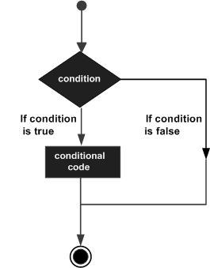
Java If-else Statement
The Java if statement is used to test the condition. It checks boolean condition: true or false. There are various types of if statement in Java.
if statement
if-else statement
if-else-if ladder
nested if statement
Syntax:
if(condition)
{
//code to be executed
}

Slide 24
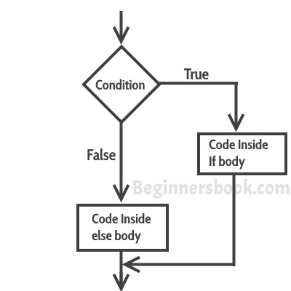
if-else statement
if(condition)
{
// Statements inside body of if
}
Else
{
//Statements inside body of else
}

Slide 25
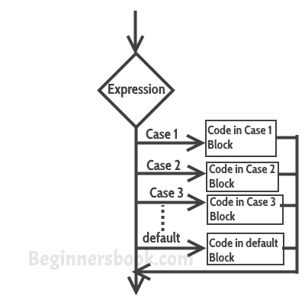
switch case statement :
The switch case statement is used when we have multiple options and we need to perform a different task for each option.
switch (variable or an integer expression)
{
case constant:
//C Statements ;
case constant:
//C Statements ;
default:
//C Statements ;
}

